Slide 1
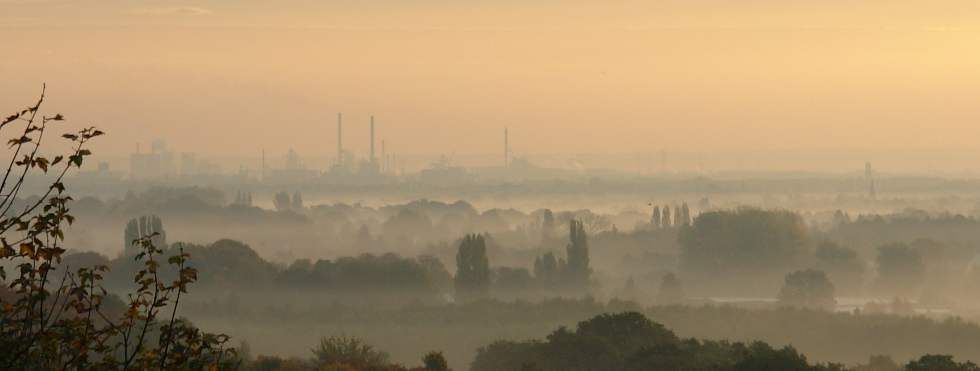
Our energy, our health
Fill in your information

Slide 2
Instructions slide
Pick and choose which slides work best for your audience. Delete what you don’t need.
Anything highlighted in yellow should be filled in by you.
Select the background slides that will work best for your audience (if any are necessary).
Notes:
Delete this slide!
Depending on your audience, select from the following set of slides that will speak best to your audience. These slides will likely fit best at the beginning to frame this discussion but select what works and where it works best to fit them in!

Slide 3
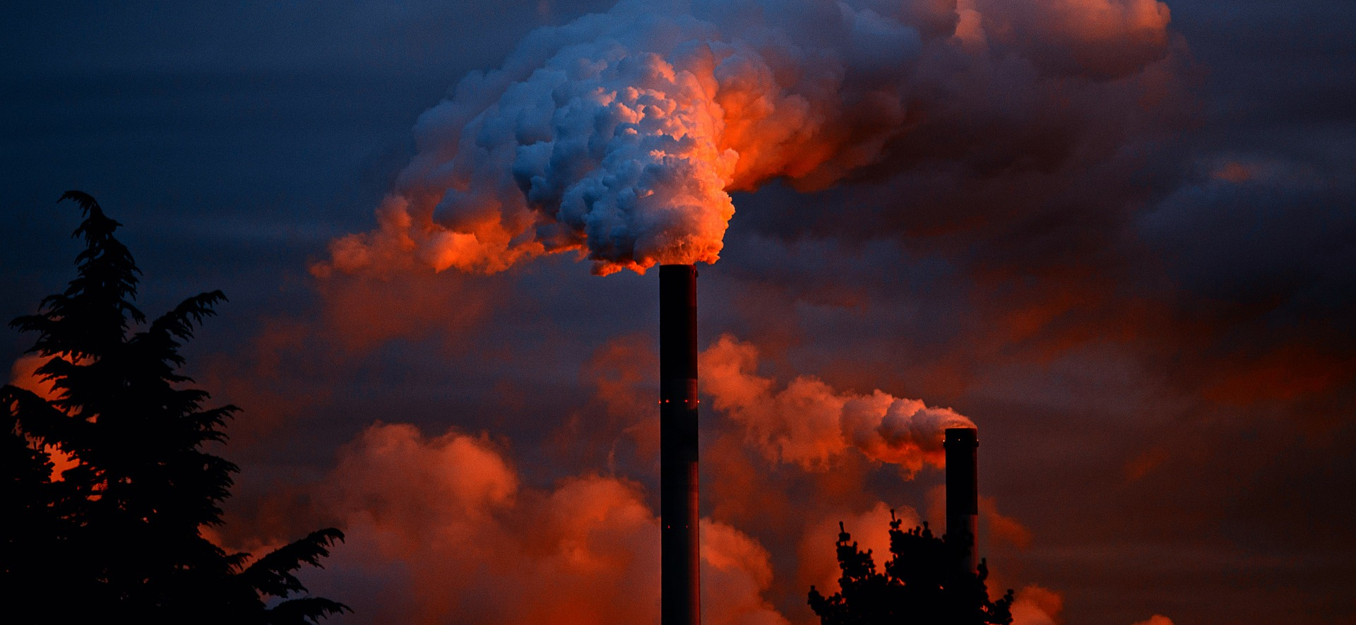
Energy and our health | Health care itself is a major contributor
The health care sector is responsible for nearly 10% of greenhouse gas emissions in the United States, with hospitals accounting for over one-third of those emissions.
The U.S. health care sector spends over $9.5 billion on energy each year and uses 2.5 times more energy per square foot than an office building of the same size.
Hospitals are major polluters and energy consumers.
Notes:
Sources:
https://journals.plos.org/plosone/article?id=10.1371/journal.pone.0157014
https://www.eia.gov/consumption/commercial/data/2012/c&e/cfm/c13.php

Slide 4
Energy and our health | Energy choices are health decisions
Hospitals are highly energy intensive, using 2.5 times more energy per square foot than an office building of the same size.
The cleanest form of energy is energy not used. Depending on margin, every $1 a nonprofit health care organization saves on energy is equivalent to generating at least $20 in new patient revenue for hospitals.
Energy savings help hospitals divert savings to patient care and reduce health care costs.
Notes:
This infographic depicts the pathways through which energy production leads to environmental disruption and ultimately health outcomes. Download is available at www.healthyenergyinitiative.org/health-impacts-of-energy-choices/.
Fossil fuel combustion is a major contributor to air pollution. Air pollution caused 7 million premature deaths in 2012, making it…
• the culprit behind 1 in 8 deaths around the world
• the #1 global environmental health risk
• a risk factor that kills more than twice as many people than malaria, HIV/AIDS, and tuberculosis combined
Source: Buchanan S, Burt E, Orris P (2015). “Beyond black lung: Scientific evidence of health effects from coal use in electricity generation.” Journal of Public Health Policy (2014) 35, 266-277. http://dx.doi.org/10.1057/jphp.2014.16
Sources:
eia.gov/consumption/commercial/reports/2012/energyusage/
https://www.energystar.gov/ia/partners/publications/pubdocs/healthcare.pdf
Download available at www.healthyenergyinitiative.org/health-impacts-of-energy-choices/ - there is also another great comparison of the Health Impacts of Energy Choices

Slide 5
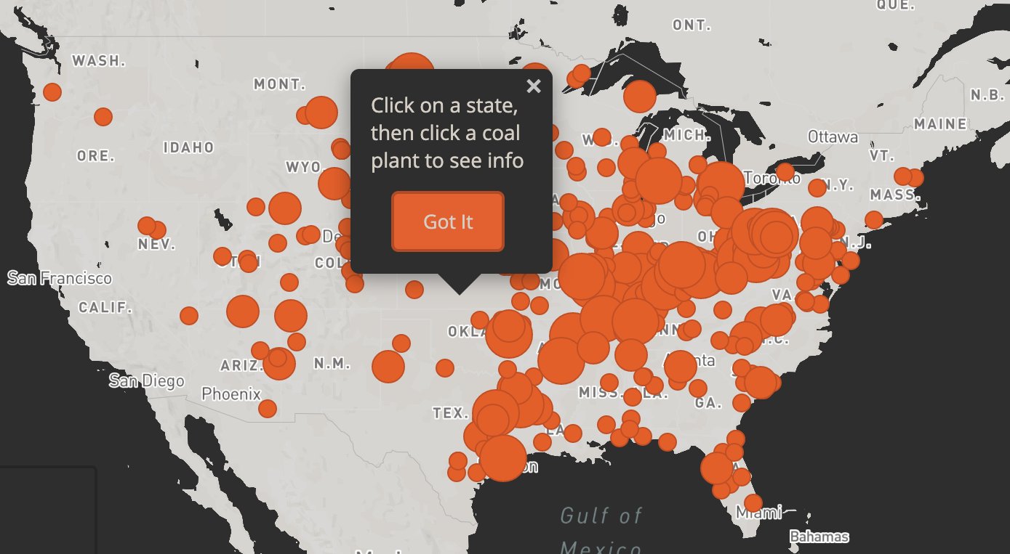
Energy and our health | Health impacts of fossil fuel usage
Estimates based on zip code for death and disease due to coal plant fine particulate matter (PM2.5) per year
Notes:
The Clean Air Task Force (CATF) produced a website called “Toll from Coal” where you can plug in your zip code and find out the health impact of coal fired power plants.

Slide 6
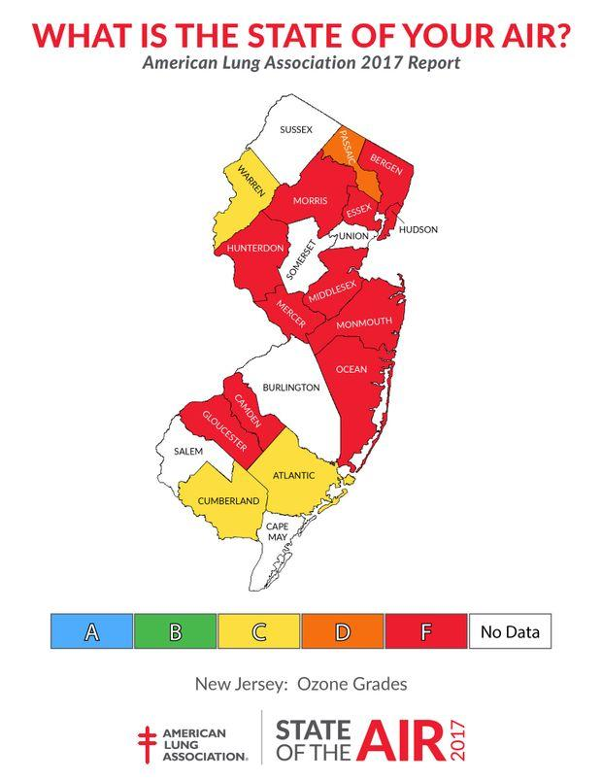
Energy and our health | Air pollution means we’re paying with our health
[UPDATE FOR YOUR REGION WITH LINK FROM NOTES]
Notes:
Access your state’s information and add it to the slide: http://www.lung.org/local-content/california/our-initiatives/state-of-the-air/2018/state-of-the-air-2018.html
When it comes to fossil fuel energy sources, it’s not as “cheap” as we thought…we’re literally paying with our health.
Fill in talking points based on your region’s ALA State of the Air report.

Slide 7
Energy and our health | How the Calculator works
Sources:
Emissions associated with electricity consumption: eGRID and EPA’s AVoided Emissions and geneRation Tool (AVERT)
Emissions associated with thermal load: EPA’s AP-42 Compilation of Air Emissions Factors and EPA’s Energy Star program
Health and welfare impacts of emissions: EPA’s Co-Benefits Risk Assessment Screening Model (COBRA)
Value of health and welfare impacts: EPA’s Co-Benefits Risk Assessment Screening Model (COBRA)
Other data sources: Federal Reserve Bank of St. Louis, Rice and Hammitt “Economic Value of Human Health Benefits of Controlling Mercury Emissions from U.S. Coal-Fired Power Plants”, other EPA documentation
Notes:
The Energy and Health Impact Calculator is a free tool developed by Health Care Without Harm and Practice Greenhealth to help health care facilities and other users assess the health impacts of their electricity and thermal energy consumption.
The Calculator converts user-input electricity and thermal energy consumption data into expected health and welfare impacts, which include illness, premature mortality, missed workdays, and other effects. These results are valued using standardized rates, and both emissions and endpoint results, and their associated values, are output to the user.
Based on the geographic information provided by the user, the calculator evaluates emissions impacts at the grid-regional level, predicting county-level associated emissions totals or emissions changes, using the EPA AVERT topology that divides the contiguous United States into ten discrete regions. Emissions impacts are evaluated similarly evaluated at the county-level for the entire contiguous United States.
This process can be visualized in five distinct steps, presented in the figure on the slide.
Note that the individual steps shown in Figure 1 may reflect multiple operations. In Step 2, for example, energy data is converted to emissions results using factors that are specific to the different energy sources, including grid electricity, renewable energy, and onsite fuel combustion, and that reflect whether the user is interested in evaluated total energy consumption or a change in energy consumption. Converting emissions to endpoint incidences in Step 3 involves the use of a transport model to predict where emissions from specific power plants in the region of interest will end up—and thus where they will end up impacting health and welfare.

Slide 8
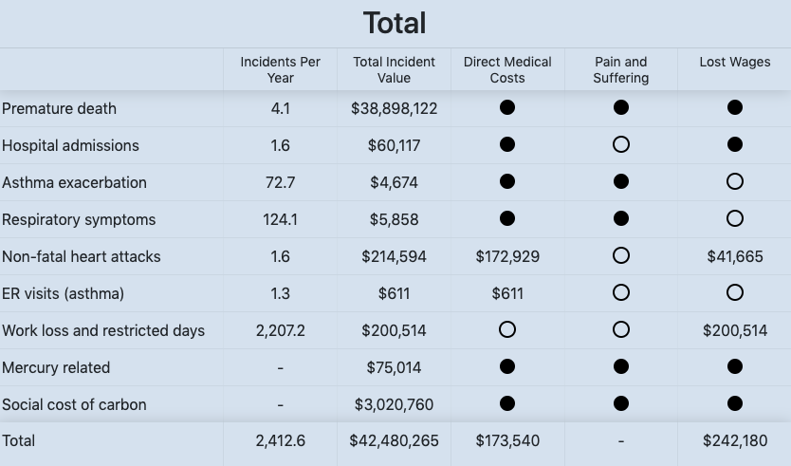
Energy and our health | XX Hospital total health results
Update image with your results
Based on annual usage from XX Hospital: XX kWh electricity, XX mmBtu natural gas, XX fuel oil, (input all fuels you use).
A full circle (●) indicates that the value is included in the total estimated value, but cannot be separately determined; an empty circle (◌) indicates that the value has not been included.
Due to dispersal patterns, social determinants of health and other environmental health factors, health impacts and costs of emissions cannot typically be attributed to a given location and population. That said, the Hippocratic Oath has no geographical limit, no exemption because those harmed might be beyond immediate sight or identified individuals.
Notes:
From the web version of the Calculator, choose the “Download Image” button to download a PNG format. Then save the file in a folder you can easily find later. In this PowerPoint file, choose Insert->Picture, then browse to the folder location where you saved the PNG image and select the file to insert.
In the Excel version of the Calculator, drag your cursor over all the table rows and columns you want to copy. Choose “Copy” from the top banner menu or by right-clicking the selection to get a menu of options. In this PowerPoint file, choose “Paste” or “Paste Special.” If you choose “Paste Special” from the Paste options, you will be able to paste as a bitmap image, which will adopt the formatting that is already built into Word or PowerPoint rather than introducing new formatting from Excel. OR you can just paste the data as an editable table, which would allow you to edit the contents of the table if needed.
Slide Notes:
All data except mercury related and social cost of carbon came from COBRA: https://www.epa.gov/statelocalenergy/co-benefits-risk-assessment-cobra-health-impacts-screening-and-mapping-tool. All values are in 2017$, assume 2017 income levels and a 3% discount rate.
1.Premature death: average of of two expected premature adult mortality studies and added with premature infant mortality
2.Hospital Admissions: represents the total expected hospitalizations for respiratory and cardiovascular illnesses, excluding heart attack. Respiratory estimate is from the pooled results of five studies that examined different age cohorts and symptoms.
3.Asthma Exacerbation: incidents of cough, shortness of breath, wheeze, or upper respiratory for 6-18 year old only. Adult values are captured in the work loss and restricted days.
4.Respiratory Symptoms: lower respiratory symptoms including acute bronchitis for children only. Adult values are captured in the work loss and restricted days.
5.Non-fatal heart attacks: average of five studies
6.ER visits (asthma): among all ages but does not include asthma exacerbation
7.Mercury related: not captured in the incidents per year but in the values from "Economic Valuation of Human Health Benefits of Controlling Mercury Emissions from U.S. Coal-Fired Power Plants" (2005). Harvard Center for Risk Analysis. This paper provides a high-end range of $182 million/ton (2000$) to $194.5 million/ton (2000$) for annual benefits, in avoided neurotoxicity and cardiovascular illness, of avoided mercury emissions from power plants. We average these values to $188.25 million/ton, and escalate this to 2017$.
8.Social cost of carbon: sourced from https://19january2017snapshot.epa.gov/climatechange/social-cost-carbon_.html.

Slide 9
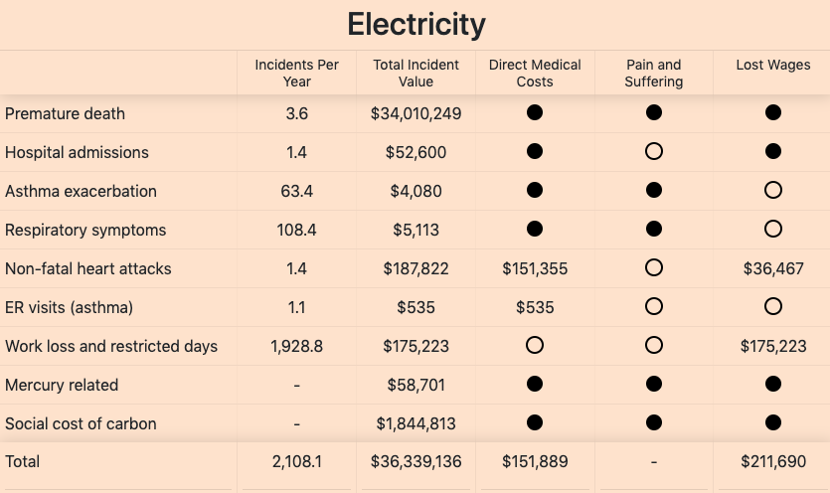
Energy and our health | XX Hospital electricity health results
Update image with your results
Based on real annual usage from XX Hospital: XX kWh electricity and XX mmBtu natural gas.
A full circle (●) indicates that the value is included in the total estimated value, but cannot be separately determined; an empty circle (◌) indicates that the value has not been included.
Notes:
From the web version of the Calculator, choose the “Download Image” button to download a PNG format. Then save the file in a folder you can easily find later. In this PowerPoint file, choose Insert->Picture, then browse to the folder location where you saved the PNG image and select the file to insert.
In the Excel version of the Calculator, drag your cursor over all the table rows and columns you want to copy. Choose “Copy” from the top banner menu or by right-clicking the selection to get a menu of options. In this PowerPoint file, choose “Paste” or “Paste Special.” If you choose “Paste Special” from the Paste options, you will be able to paste as a bitmap image, which will adopt the formatting that is already built into Word or PowerPoint rather than introducing new formatting from Excel. OR you can just paste the data as an editable table, which would allow you to edit the contents of the table if needed.
Slide Notes:
All data except mercury related and social cost of carbon came from COBRA: https://www.epa.gov/statelocalenergy/co-benefits-risk-assessment-cobra-health-impacts-screening-and-mapping-tool. All values are in 2017$, assume 2017 income levels and a 3% discount rate.
1.Premature death: average of of two expected premature adult mortality studies and added with premature infant mortality
2.Hospital Admissions: represents the total expected hospitalizations for respiratory and cardiovascular illnesses, excluding heart attack. Respiratory estimate is from the pooled results of five studies that examined different age cohorts and symptoms.
3.Asthma Exacerbation: incidents of cough, shortness of breath, wheeze, or upper respiratory for 6-18 year old only. Adult values are captured in the work loss and restricted days.
4.Respiratory Symptoms: lower respiratory symptoms including acute bronchitis for children only. Adult values are captured in the work loss and restricted days.
5.Non-fatal heart attacks: average of five studies
6.ER visits (asthma): among all ages but does not include asthma exacerbation
7.Mercury related: not captured in the incidents per year but in the values from "Economic Valuation of Human Health Benefits of Controlling Mercury Emissions from U.S. Coal-Fired Power Plants" (2005). Harvard Center for Risk Analysis. This paper provides a high-end range of $182 million/ton (2000$) to $194.5 million/ton (2000$) for annual benefits, in avoided neurotoxicity and cardiovascular illness, of avoided mercury emissions from power plants. We average these values to $188.25 million/ton, and escalate this to 2017$.
8.Social cost of carbon: sourced from https://19january2017snapshot.epa.gov/climatechange/social-cost-carbon_.html.

Slide 10
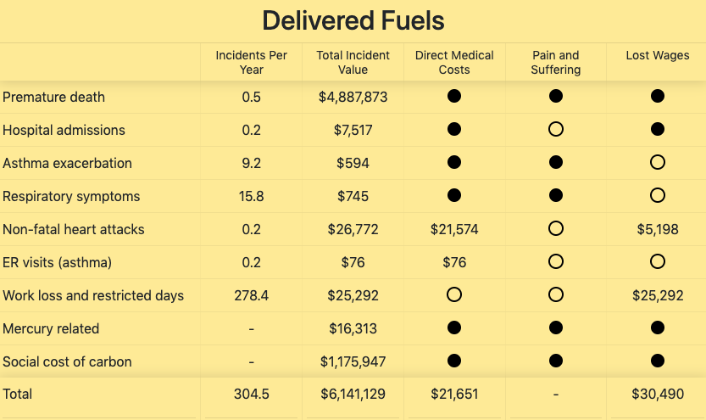
Energy and our health | XX Hospital delivered fuels health results
Update image with your results
Based on real annual usage from XX Hospital: XX kWh electricity and XX mmBtu natural gas.
A full circle (●) indicates that the value is included in the total estimated value, but cannot be separately determined; an empty circle (◌) indicates that the value has not been included.
Notes:
From the web version of the Calculator, choose the “Download Image” button to download a PNG format. Then save the file in a folder you can easily find later. In this PowerPoint file, choose Insert->Picture, then browse to the folder location where you saved the PNG image and select the file to insert.
In the Excel version of the Calculator, drag your cursor over all the table rows and columns you want to copy. Choose “Copy” from the top banner menu or by right-clicking the selection to get a menu of options. In this PowerPoint file, choose “Paste” or “Paste Special.” If you choose “Paste Special” from the Paste options, you will be able to paste as a bitmap image, which will adopt the formatting that is already built into Word or PowerPoint rather than introducing new formatting from Excel. OR you can just paste the data as an editable table, which would allow you to edit the contents of the table if needed.
Slide Notes:
All data except mercury related and social cost of carbon came from COBRA: https://www.epa.gov/statelocalenergy/co-benefits-risk-assessment-cobra-health-impacts-screening-and-mapping-tool. All values are in 2017$, assume 2017 income levels and a 3% discount rate.
1.Premature death: average of of two expected premature adult mortality studies and added with premature infant mortality
2.Hospital Admissions: represents the total expected hospitalizations for respiratory and cardiovascular illnesses, excluding heart attack. Respiratory estimate is from the pooled results of five studies that examined different age cohorts and symptoms.
3.Asthma Exacerbation: incidents of cough, shortness of breath, wheeze, or upper respiratory for 6-18 year old only. Adult values are captured in the work loss and restricted days.
4.Respiratory Symptoms: lower respiratory symptoms including acute bronchitis for children only. Adult values are captured in the work loss and restricted days.
5.Non-fatal heart attacks: average of five studies
6.ER visits (asthma): among all ages but does not include asthma exacerbation
7.Mercury related: not captured in the incidents per year but in the values from "Economic Valuation of Human Health Benefits of Controlling Mercury Emissions from U.S. Coal-Fired Power Plants" (2005). Harvard Center for Risk Analysis. This paper provides a high-end range of $182 million/ton (2000$) to $194.5 million/ton (2000$) for annual benefits, in avoided neurotoxicity and cardiovascular illness, of avoided mercury emissions from power plants. We average these values to $188.25 million/ton, and escalate this to 2017$.
8.Social cost of carbon: sourced from https://19january2017snapshot.epa.gov/climatechange/social-cost-carbon_.html.

Slide 11
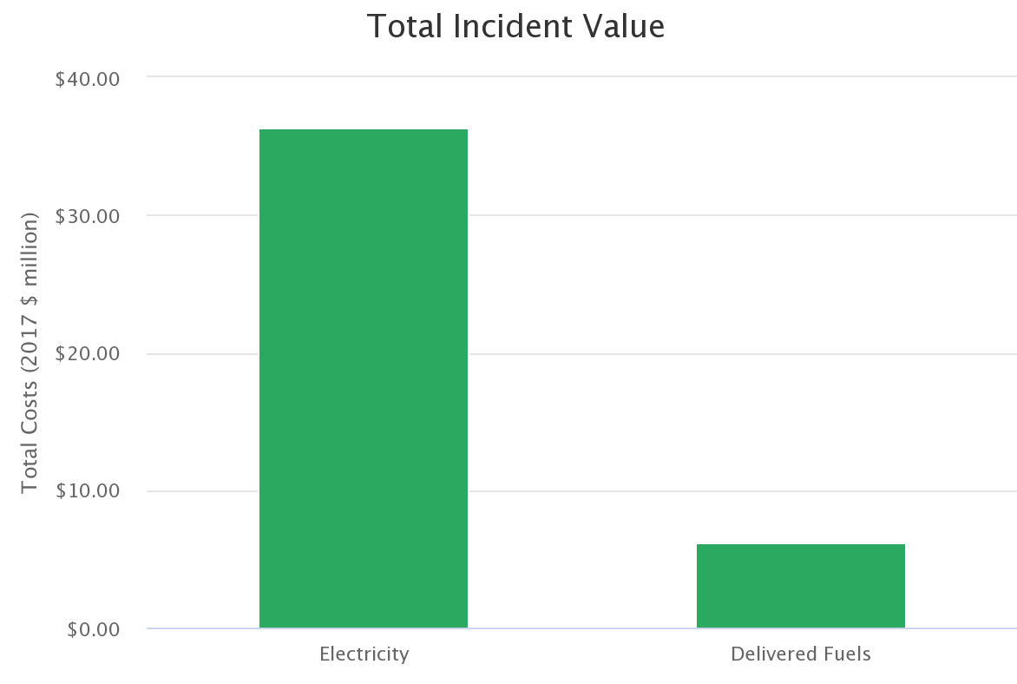
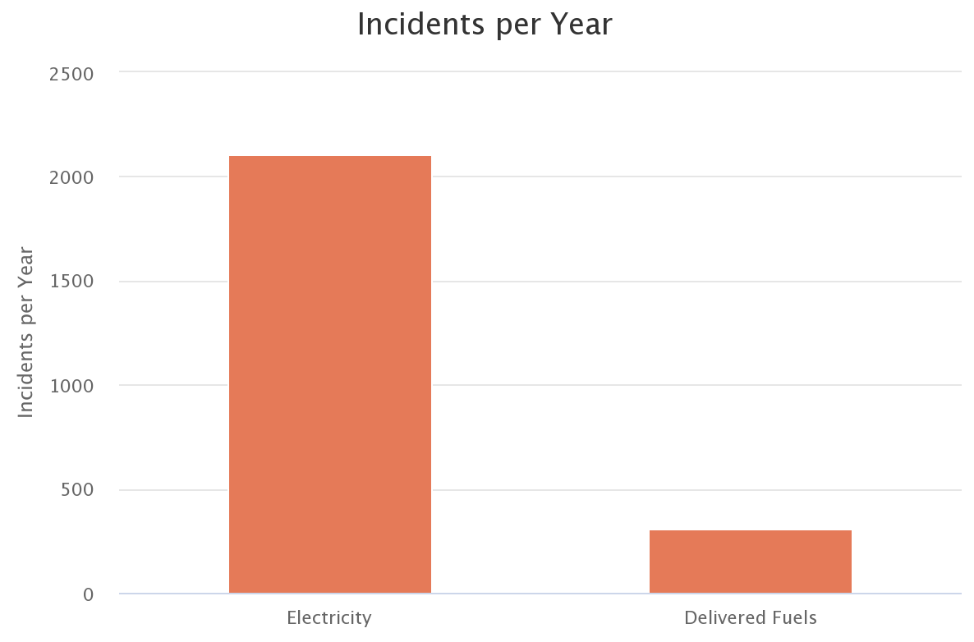
Energy and our health | XX Hospital comparison - where is it coming from?
Based on real annual usage from XX Hospital: XX kWh electricity and XX mmBtu natural gas → purchased electricity
Notes:
From the web version of the Calculator, click the “download” menu at the top right corner of the graph you’re interested in capturing. Then choose “PNG.” Save the file in a folder you can easily find later. In this PowerPoint file, choose Insert->Picture, then browse to the folder location where you saved the PNG image and select the file to insert.
In the Excel version of the Calculator, select the graph you would like to copy. Choose “Copy” from the top banner menu or by right-clicking the graph to get a menu of options. In this PowerPoint file, choose “Paste” or “Paste Special.” If you choose “Paste Special” from the Paste options, you will be able to paste the graph as a static image (for example, a PNG format) that will retain its appearance and not be editable any further. If you just choose “Paste,” the graph will be an embedded Excel object and some aspects of it will be scalable and editable.

Slide 12
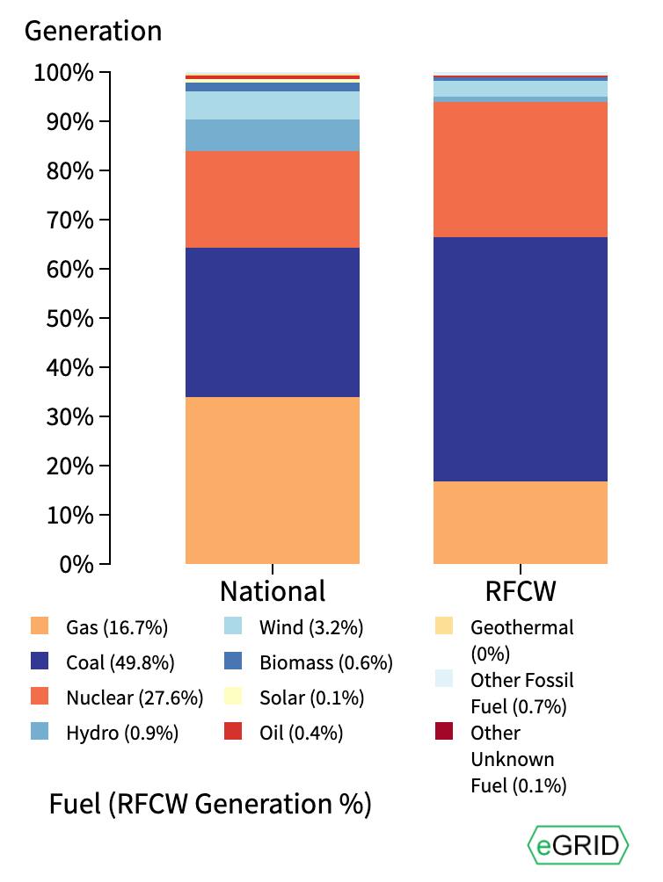
Energy and our health | XX Hospital electricity grid mix
As you can see from the EPA’s Power Profiler website, the majority of our grid mix is:
Coal (49.8%)
Natural Gas (16.7%)
Nuclear (27.6%)
Notes:
Source: EPA Power Profiler website: https://www.epa.gov/energy/power-profiler#/

Slide 13
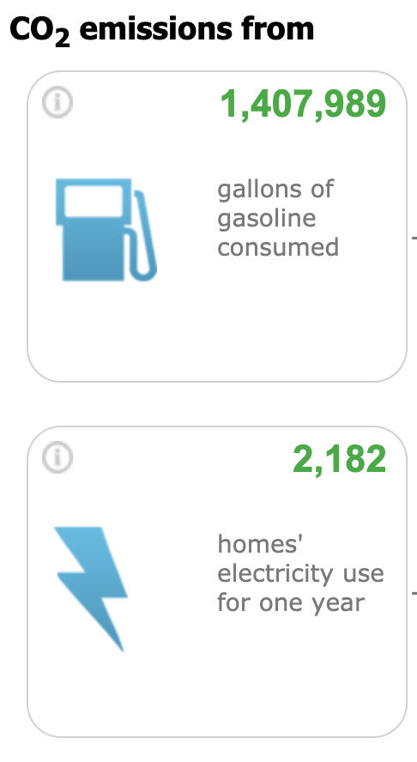
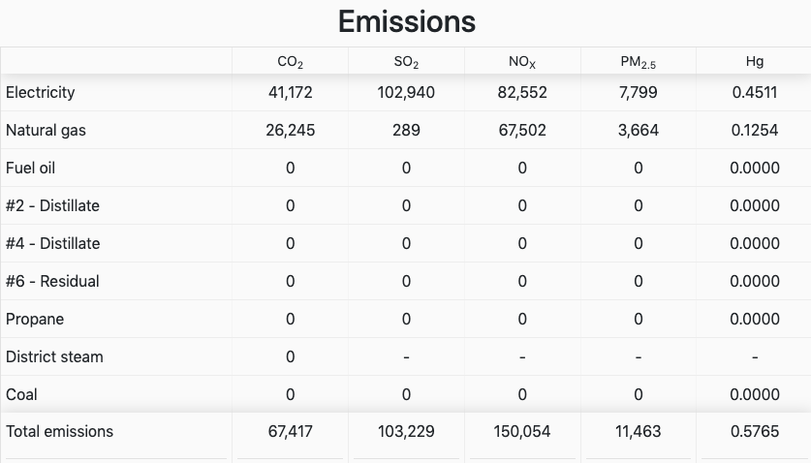
Energy and our health | XX Hospital emissions
Update image with your results
Based on real annual usage from XX Hospital: XX kWh electricity and XX mmBtu natural gas
Notes:
From the web version of the Calculator, choose the “Download Image” button to download a PNG format. Then save the file in a folder you can easily find later. In this PowerPoint file, choose Insert->Picture, then browse to the folder location where you saved the PNG image and select the file to insert.
In the Excel version of the Calculator, drag your cursor over all the table rows and columns you want to copy. Choose “Copy” from the top banner menu or by right-clicking the selection to get a menu of options. In this PowerPoint file, choose “Paste” or “Paste Special.” If you choose “Paste Special” from the Paste options, you will be able to paste as a bitmap image, which will adopt the formatting that is already built into Word or PowerPoint rather than introducing new formatting from Excel. OR you can just paste the data as an editable table, which would allow you to edit the contents of the table if needed.
If you’re going to include this, we recommend plugging emissions into the EPA’s Greenhouse Gas Equivalencies Calculator and then selecting a few of the equivalences that will resonate with your audience.

Slide 14
Energy and our health | XX Hospital invests in energy efficiency, renewable energy, energy storage, and/or a microgrid. [choose which one(s) apply].
Summary points go here.
Notes:
Summarize your conclusions, the health impacts, and what the ask is for your audience.

